Slide 1
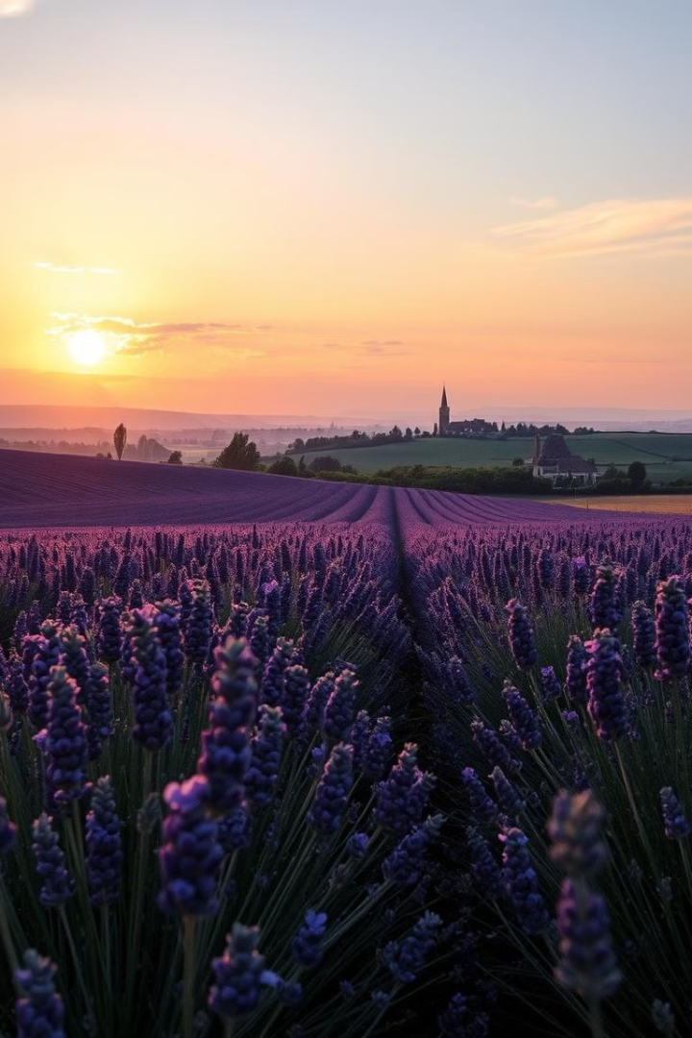
Journeys That Shaped My Life
My travels have taken me to many corners of the world, each one offering unique experiences and shaping my perspective. From the romantic charm of France to the historic grandeur of Germany and the mystique of the United Kingdom, I've explored diverse cultures and discovered the beauty of our planet.
By Arseny Komarskikh

Slide 2

France: City of Lights
and Romance
Paris
Strolling through the charming streets of Paris, I was captivated by its timeless elegance and vibrant energy. From the Louvre's masterpieces to the iconic Eiffel Tower, every corner whispered stories of love, art, and history.
Beyond Paris
Venturing beyond the capital, I discovered the beauty of the French countryside. Lavender fields bloomed in Provence, and the rolling hills of Normandy held stories of resilience and sacrifice.

Slide 3
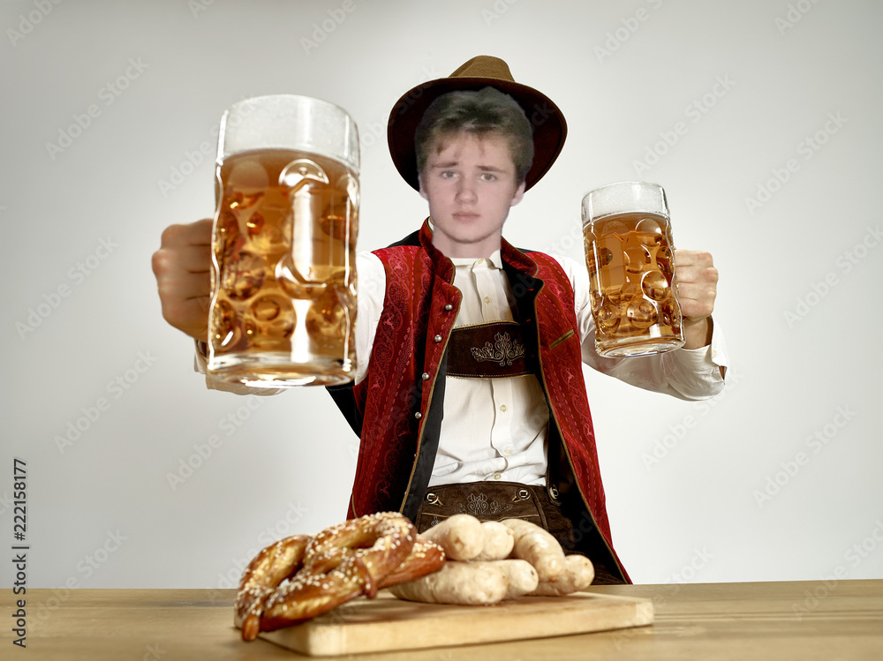
Germany: Land of Beer and History
Bavarian Charm
Munich's Oktoberfest was an unforgettable experience, filled with lively music, delicious food, and endless laughter. The vibrant atmosphere and friendly people truly captured the essence of Bavarian culture.
Historical Significance
Beyond the festivities, Germany revealed a rich history etched in its cities. Berlin's Brandenburg Gate and the imposing Neuschwanstein Castle stood as testaments to its past, offering glimpses into centuries of change.

Slide 4
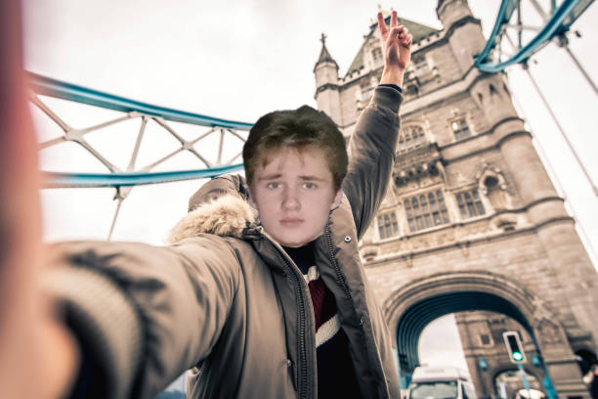
Great Britain: Foggy Albion and its Majesty
London's Allure
Countryside Beauty
London, with its bustling streets and historical landmarks, felt like a melting pot of cultures and eras. I marveled at the British Museum's treasures and stood in awe of the majestic Buckingham Palace.
Venturing beyond the city, I explored the charming villages and rolling hills of the English countryside. Picturesque landscapes painted a picture of peace and tranquility, a stark contrast to the urban buzz.

Slide 5
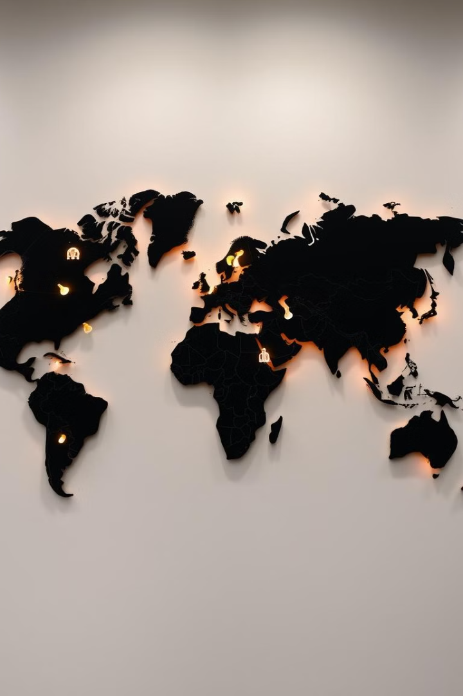


The Impact on My Worldview
Broadening Horizons
Increased Empathy
Traveling opened my eyes to the vast diversity of cultures, beliefs, and perspectives. I learned to appreciate the beauty in difference and the importance of understanding other viewpoints.
I gained a deeper understanding of humanity and the shared experiences that connect us all. I learned to see the world through different lenses and to appreciate the interconnectedness of our global community.

Slide 6

Unforgettable Moments and Encounters
1
Friendly Locals
I encountered warm and welcoming locals who shared their stories, traditions, and love for their homelands. These interactions were truly enriching and unforgettable.
2
Cultural Immersion
I experienced the joy of celebrating local festivals, sampling traditional cuisine, and participating in cultural events. These immersive experiences provided a deeper understanding of the local way of life.
3
Inspiring Conversations
Conversations with fellow travelers from around the world broadened my perspectives. We shared stories, exchanged ideas, and forged meaningful connections that transcended borders.

Slide 7
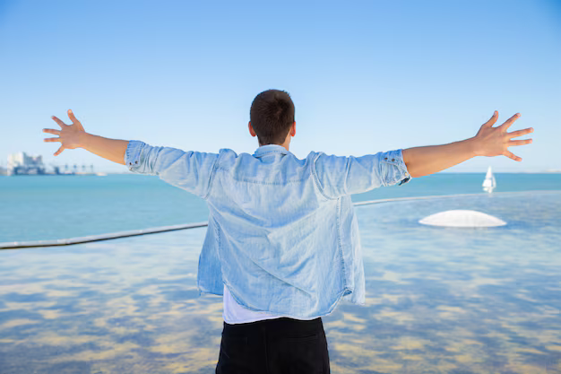



Lessons Learned Through Travel
Resilience
Travel often throws unexpected challenges, but I learned to adapt, overcome obstacles, and emerge stronger. The ability to navigate the unknown became a valuable skill.
Open-Mindedness
I discovered the power of embracing new experiences and perspectives. I learned to challenge my assumptions and to appreciate the beauty in diversity.
Self-Discovery
Travel forced me to confront my comfort zone and step outside of my familiar surroundings. I gained a better understanding of myself and my place in the world.

Slide 8



Why I Recommend Travel
Personal Growth
1
Travel fosters personal growth, broadens perspectives, and enhances self-awareness.
Cultural Understanding
2
Travel promotes cross-cultural understanding and appreciation for the beauty in diversity.
Worldly Experiences
3
Travel creates opportunities for unique experiences, unforgettable memories, and a deeper connection to the world.

